Slide 1
Comparative analysis of viola jones and faster RCNN for object detection
Presented by-
G. Anupama
Ruhani Sharma

Slide 2
Table of contents
01
02
03
Overview
Viola Jones
Faster RCNN
04
05
06
Results
Comparison
Inferences and conclusion
Overview of object detection
Introduction and working mechanism
Introduction and working mechanism
Results of viola and faster RCNN on PASCAL VOC dataset
Speed, accuracy and visual comparison

Slide 3
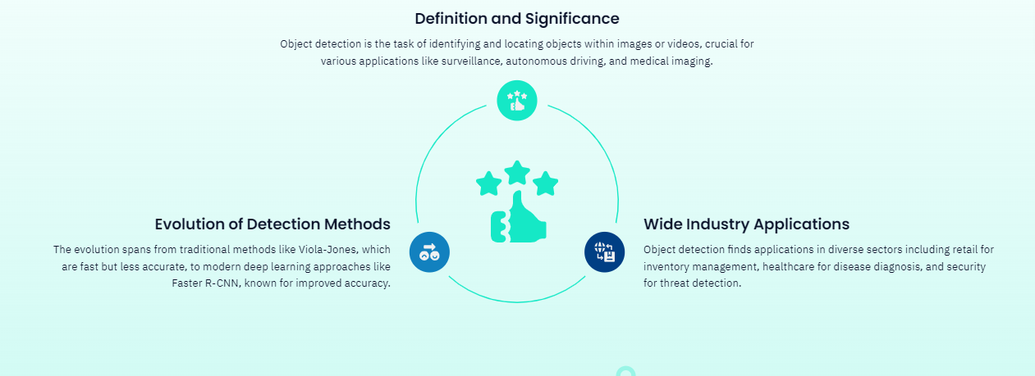
Overview of object detection

Slide 4
Introduction to Viola Jones
1.
Developed by
2.
3.
Key features
Cascade classifiers
Paul Viola
Michal Jones
Haar-like features
Integral image
Adaboost
Purpose
Object detection, face detection

Slide 5
Introduction to Faster RCNN
1.
Developed by
2.
3.
Key features
Shaoqing Ren, Kaiming He, Ross B. Girshick, and Jian Sun in 2015
Incorporates Region Proposal Network (RPN), shared convolutional layers, and Fast R-CNN module
Purpose
General-purpose object detection framework

Slide 6

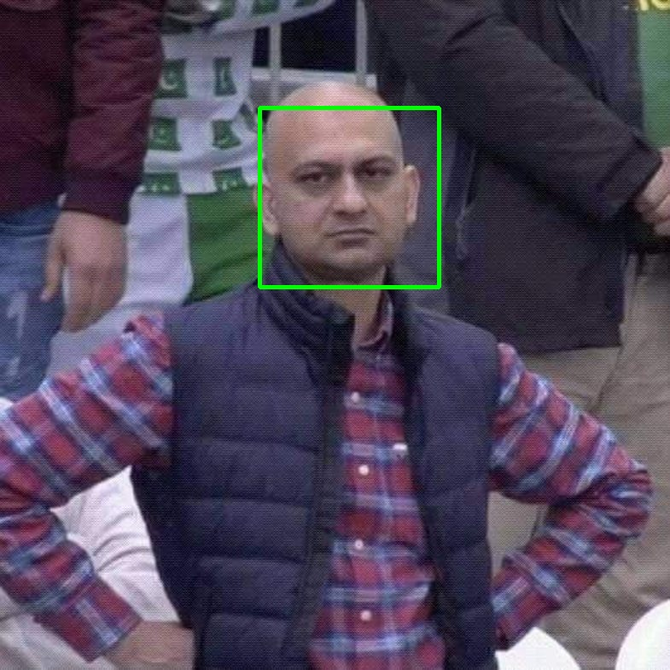
Viola Jones on one image
Before
After

Slide 7
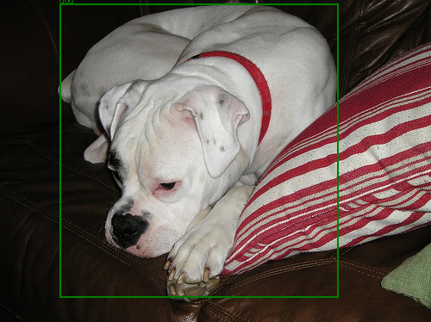
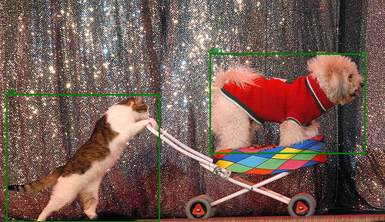
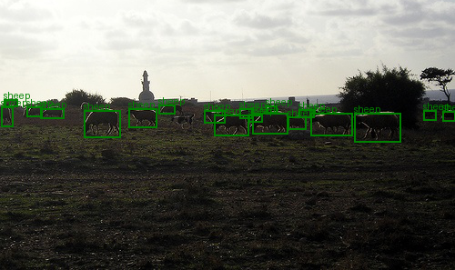
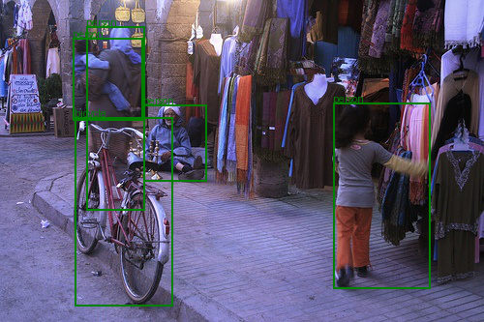
Viola Jones on PASCAL VOC

Slide 8

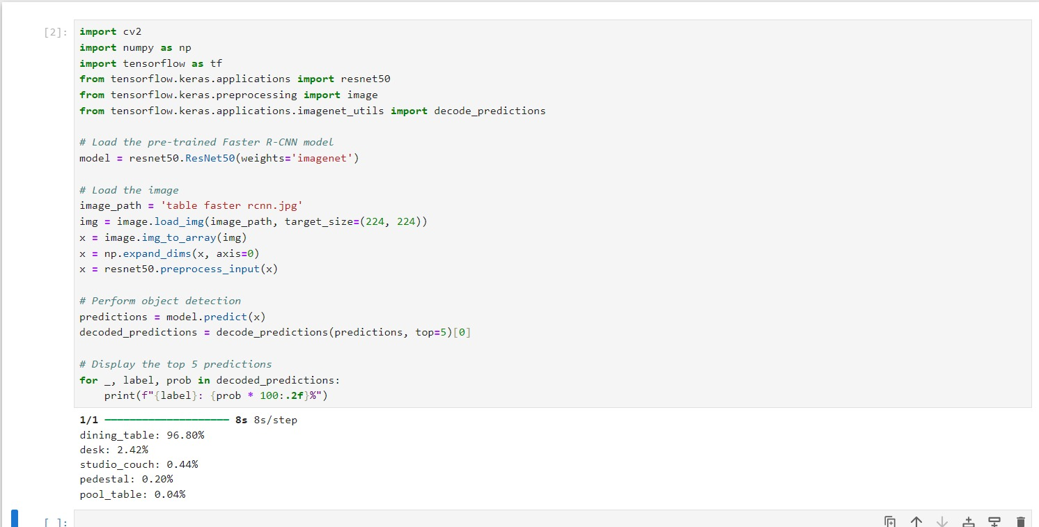
Faster RCNN on one image
image
Result

Slide 9
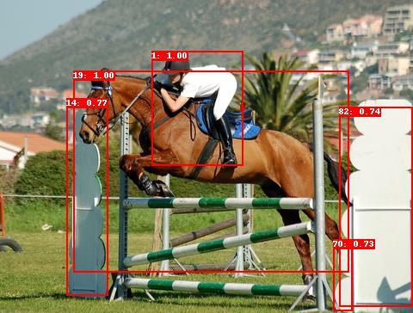
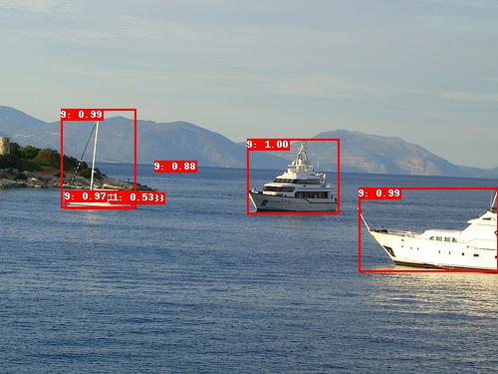
Faster RCNN on PASCAL VOC

Slide 10
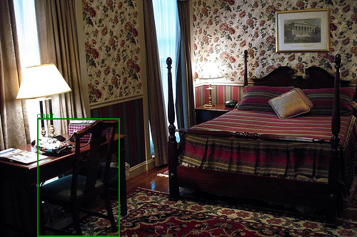
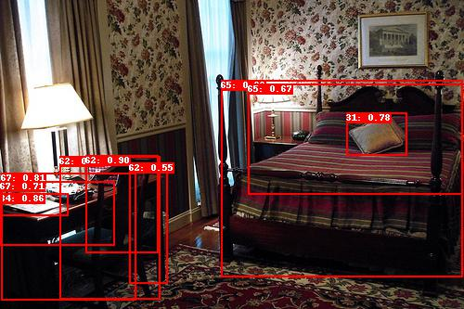
Side by side comparison

Slide 11
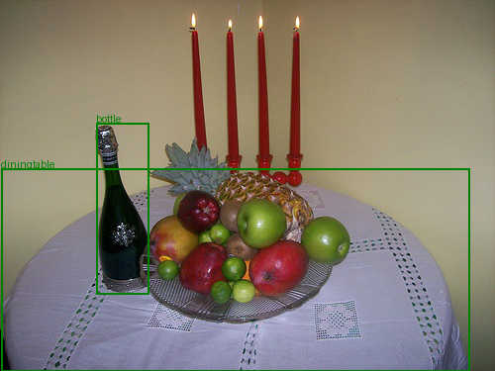
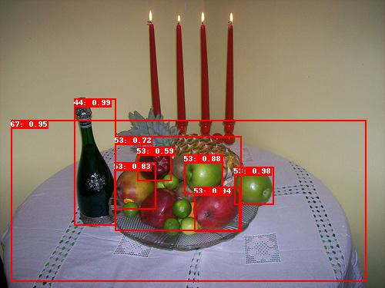

Slide 12
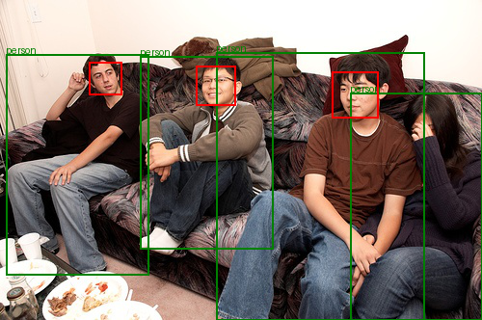
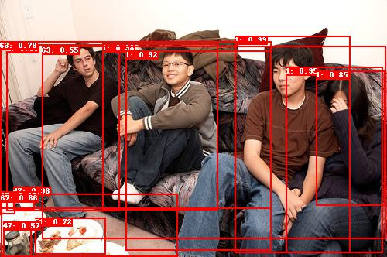

Slide 13
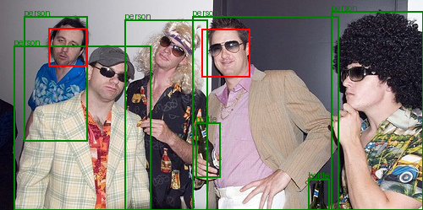
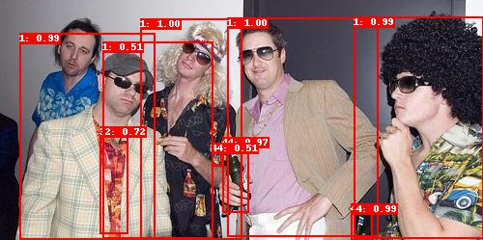

Slide 14
Comparative analysis
 | Detection Accuracy | speed | Computational complexity
Viola Jones | Moderate | fast | Low
Faster RCNN | high | Slower | Higher

Slide 15
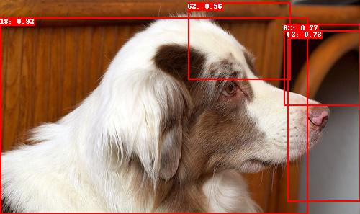
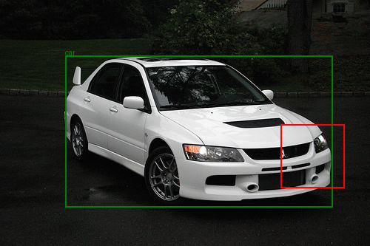
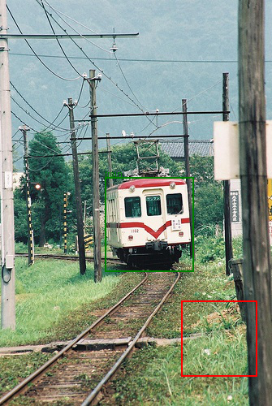
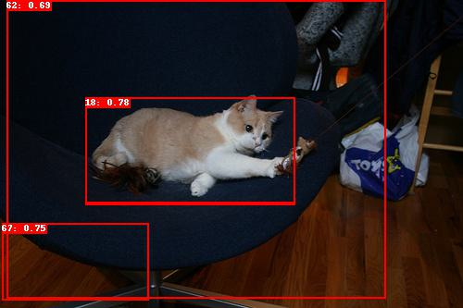
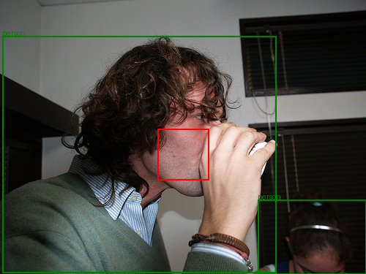
Some Failure cases

Slide 16
Conclusion and future work
In conclusion, we observed that while the Viola-Jones algorithm excels in face detection, it is not well-suited for general object detection. Conversely, Faster R-CNN performs effectively in object detection
Looking ahead, to advance this project, we plan to implement the DINO architecture on our dataset. This approach promises to enhance the accuracy and robustness of our object detection capabilities.

Slide 17
Referred Papers
Title
Rapid Object Detection using a Boosted Cascade of Simple Features
Authors
Paul Viola and Michael Jones
Published
Presented at the IEEE Computer Society Conference on Computer Vision and Pattern Recognition (CVPR) in 2001.
Title
Faster R-CNN: Towards Real-Time Object Detection with Region Proposal Networks
Authors
Shaoqing Ren, Kaiming He, Ross B. Girshick, and Jian Sun
Published
In the proceedings of the Advances in Neural Information Processing Systems (NIPS) conference, 2015.

Slide 18
THANK YOU

